Slide 1
E90 Project: Hydrogen Fuel Cell Vehicle
Gabriel Salas, Michael Moran

Slide 2

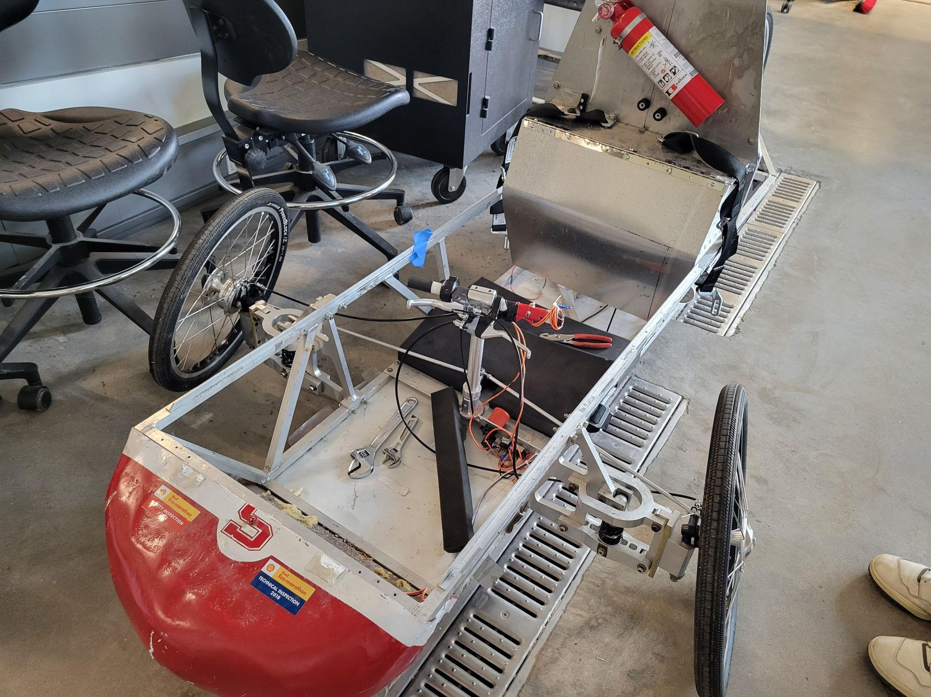

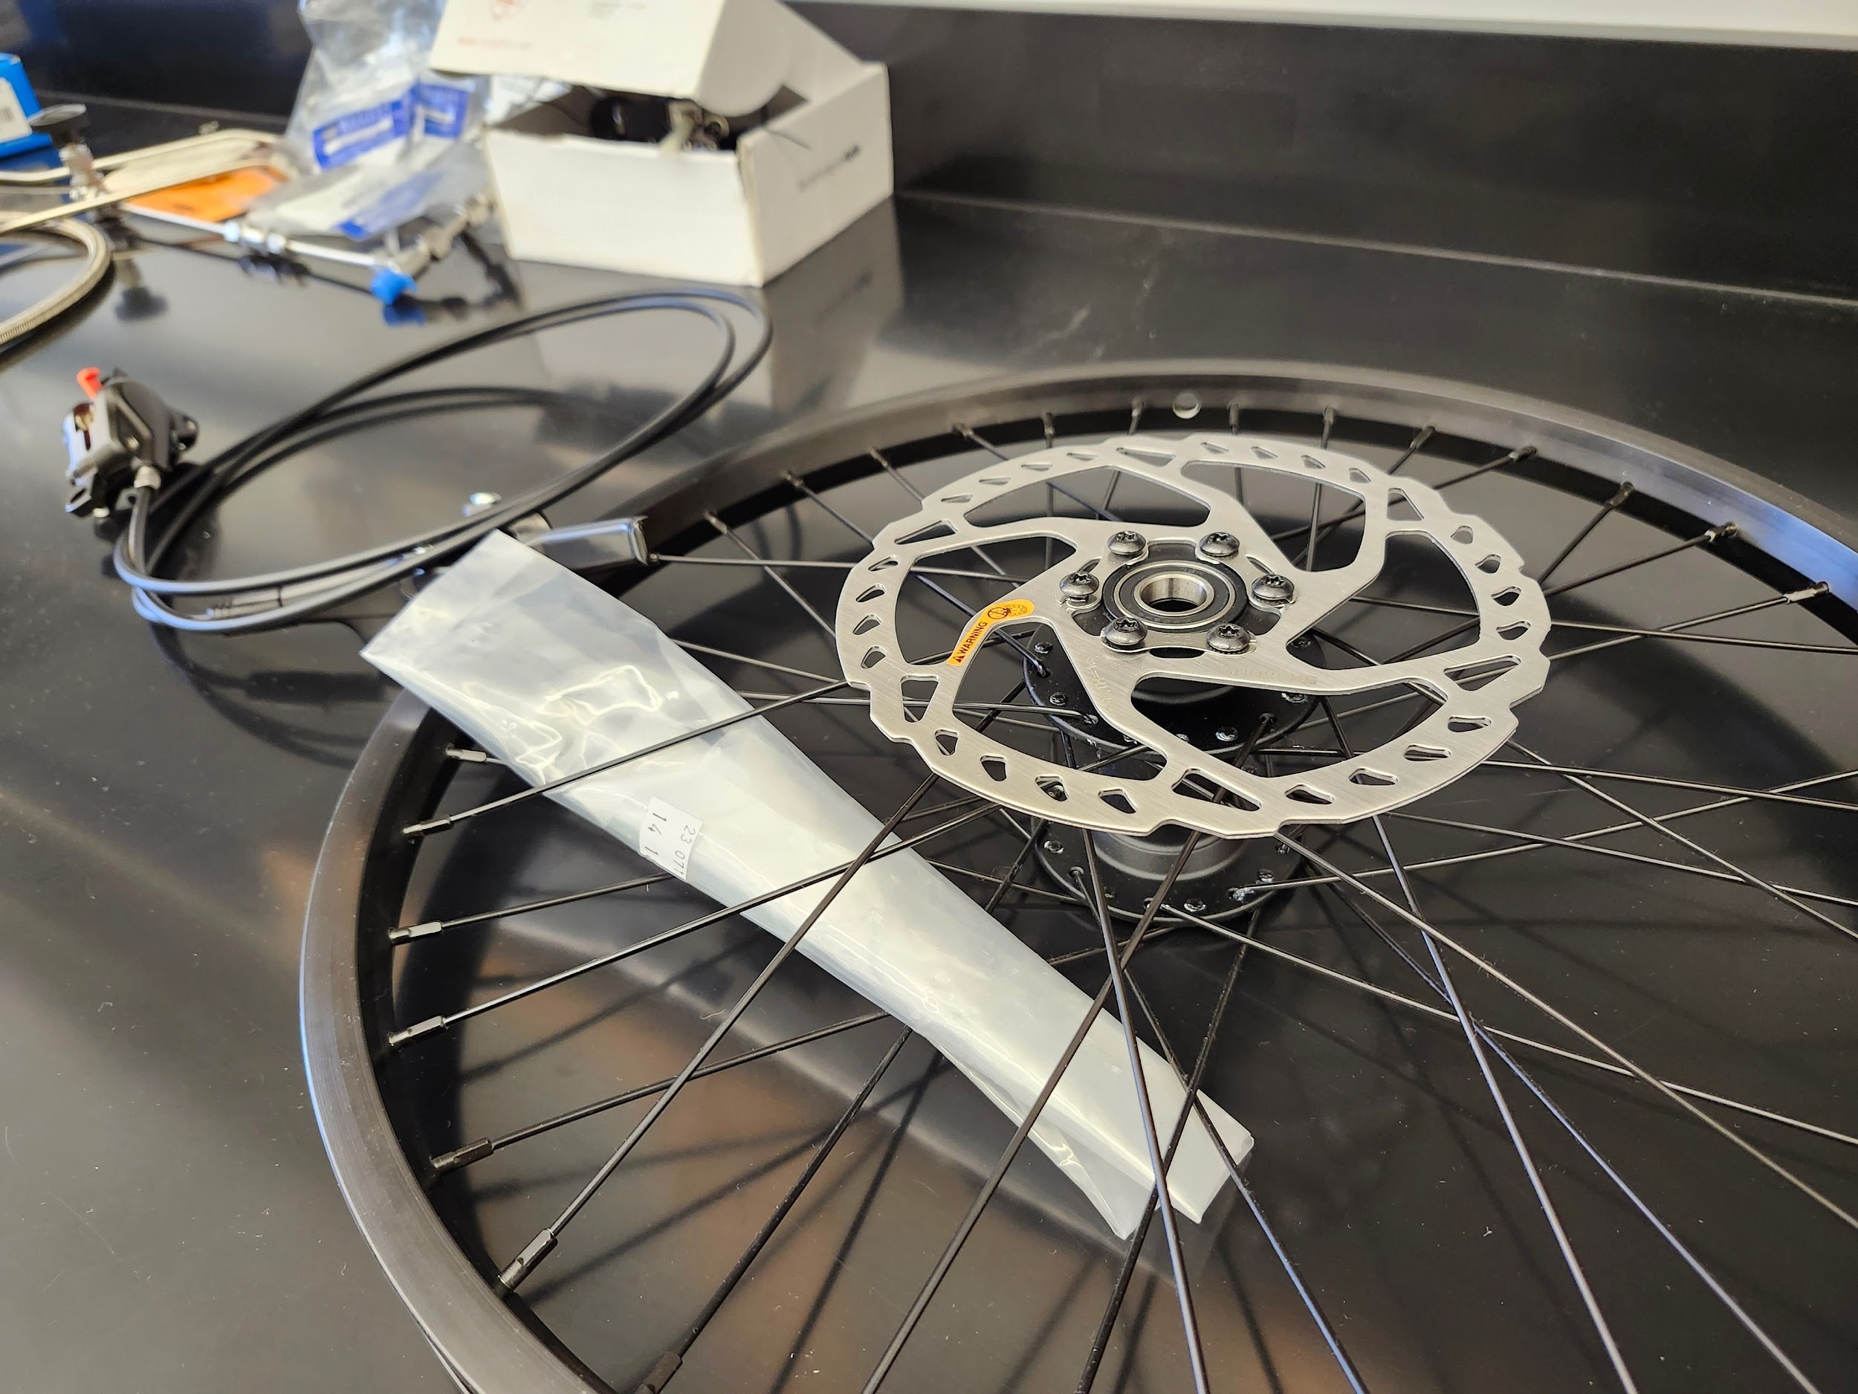
Table of Contents
Purpose and Background
Requirements and Constraints
Goals and Current Work
Next Steps

Slide 3
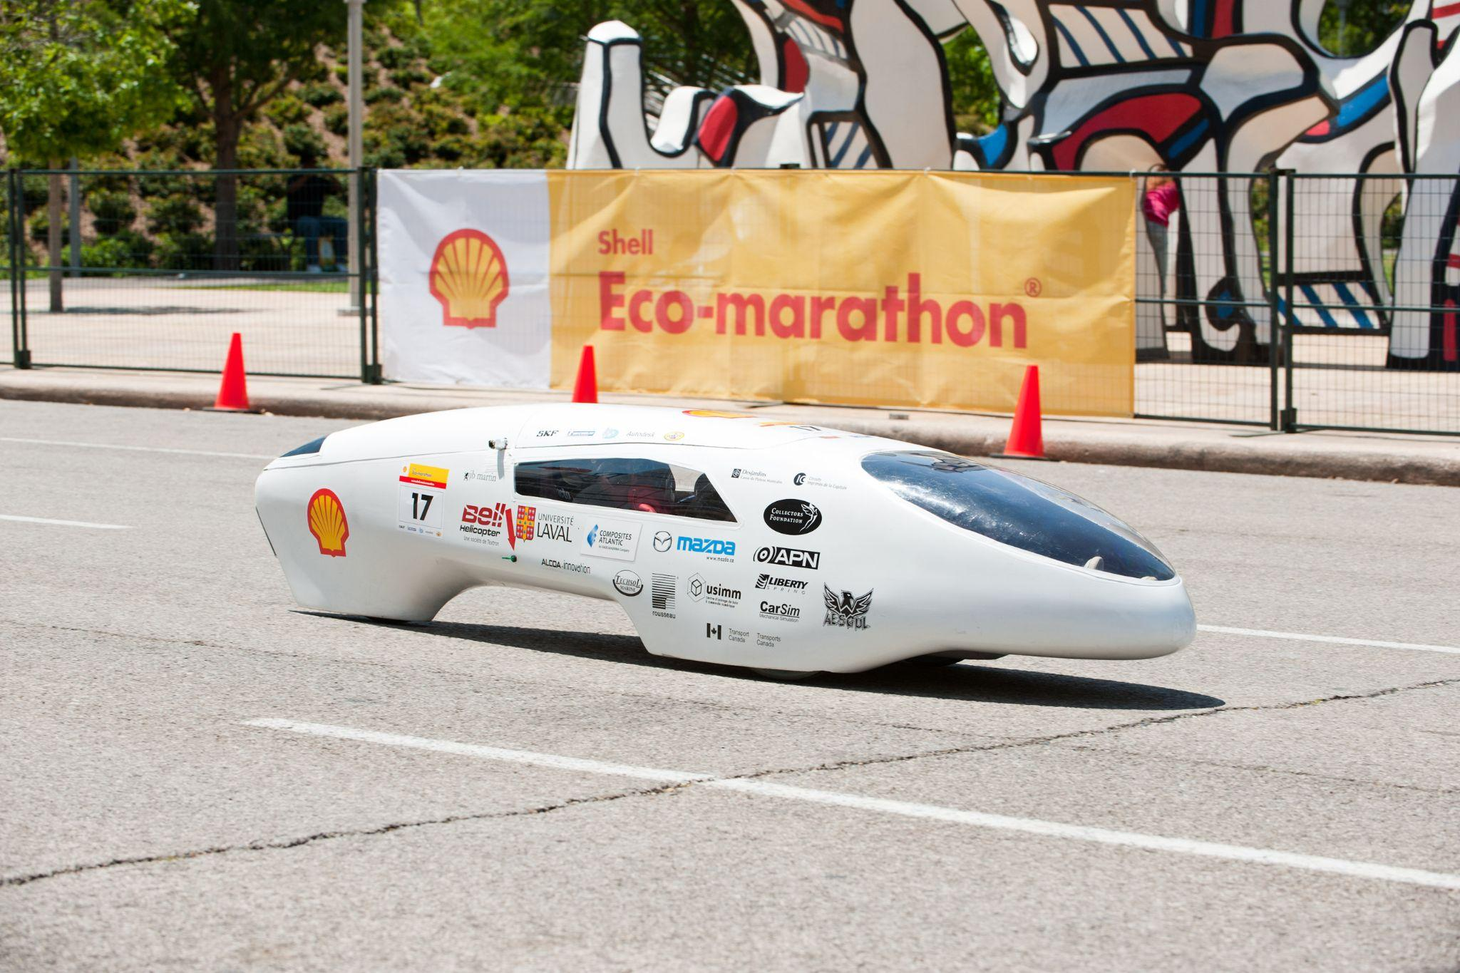
PURPOSE
The goal is to continue the work of past senior classes as well as research done by underclassmen.
Deep interest in motosport, vehicle development, and the search for alternative fuel sources

Slide 4
REQUIREMENTS & CONSTRAINTS
Requirements | Constrains
CAD / Fusion 360 Design and Development | Ordering materials + Arrival
MIG Welding | Machine Shop Availability
Manufacturing / Machining | Current Frame
3D Print RULES OF RACE | Prior Development(s) + Parts

Slide 5
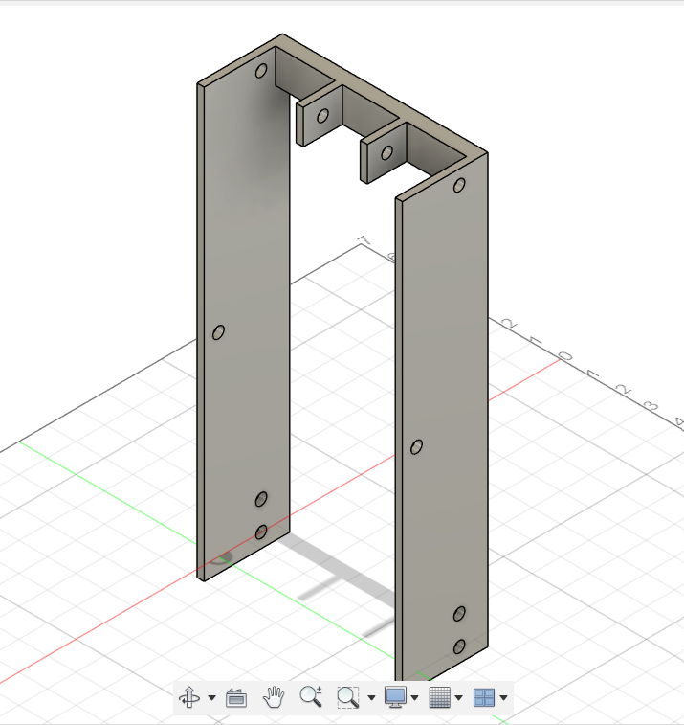
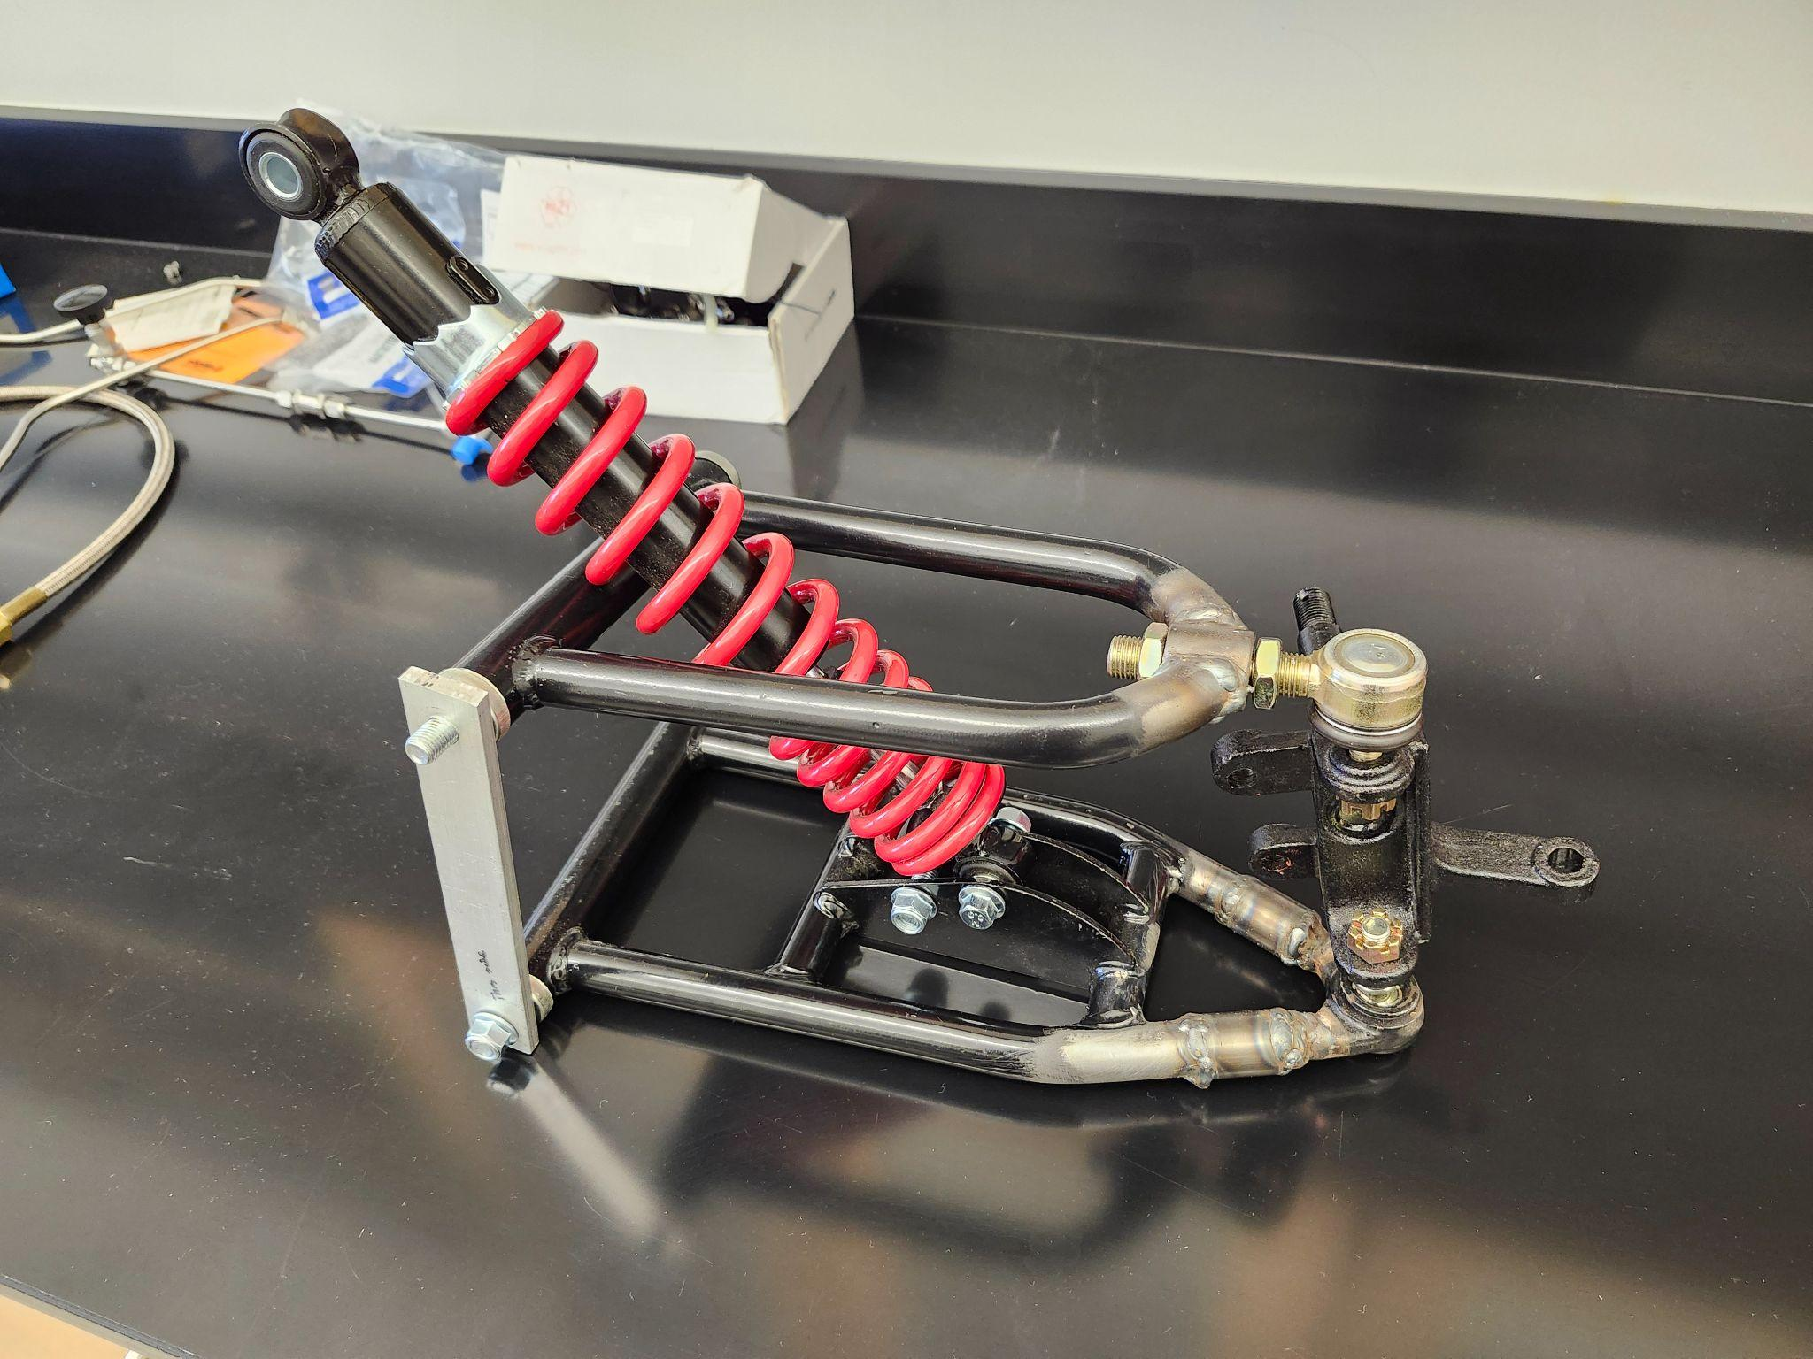
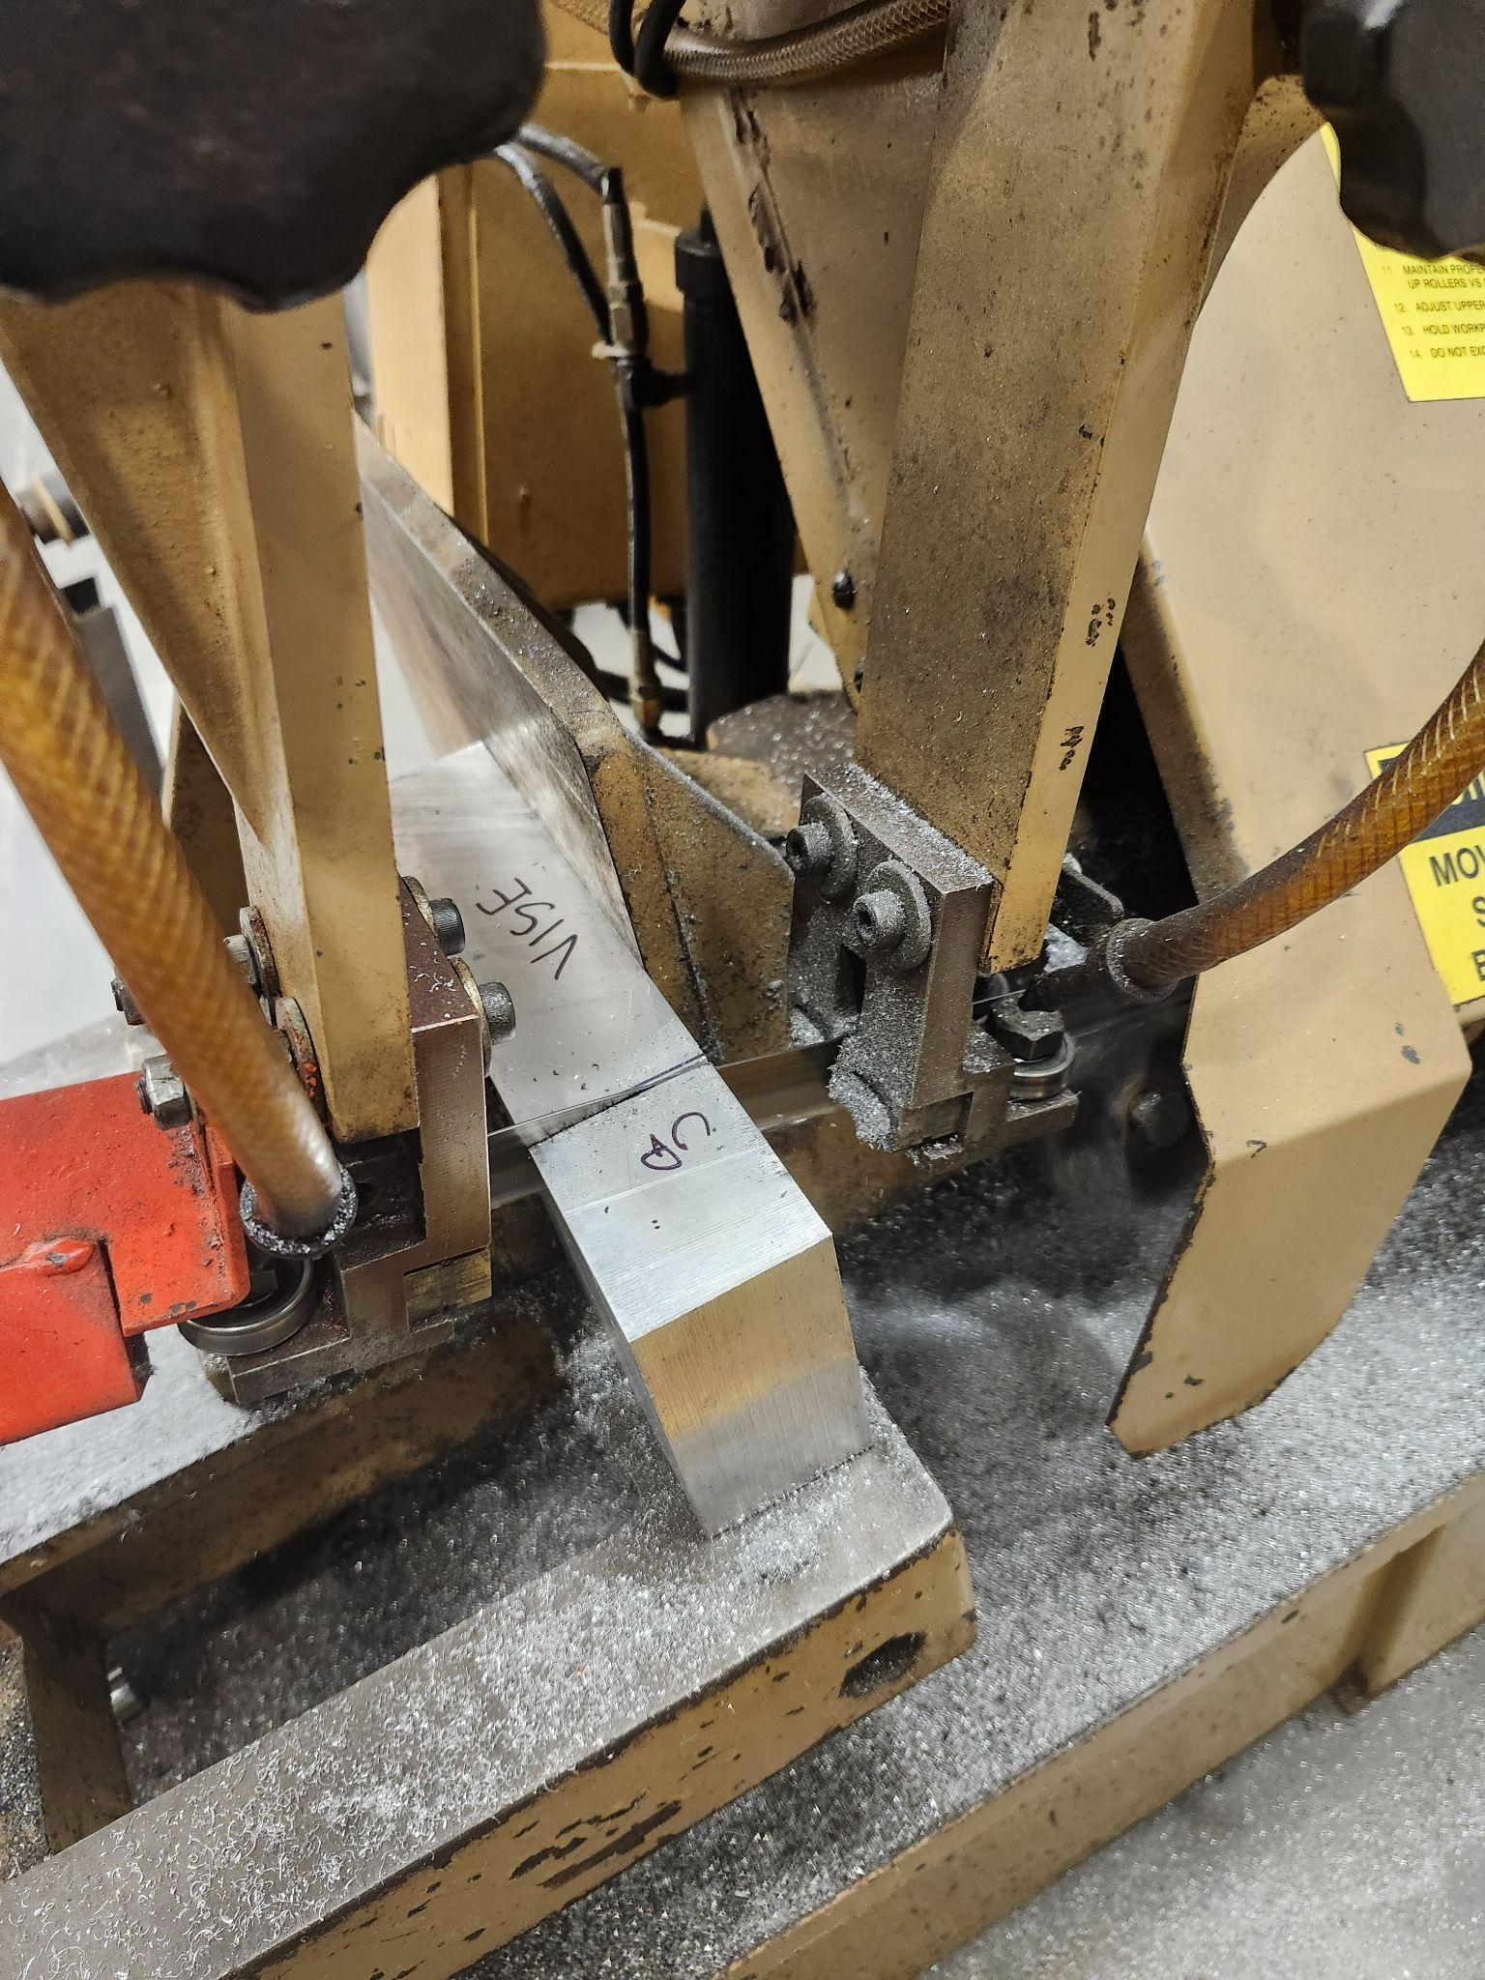
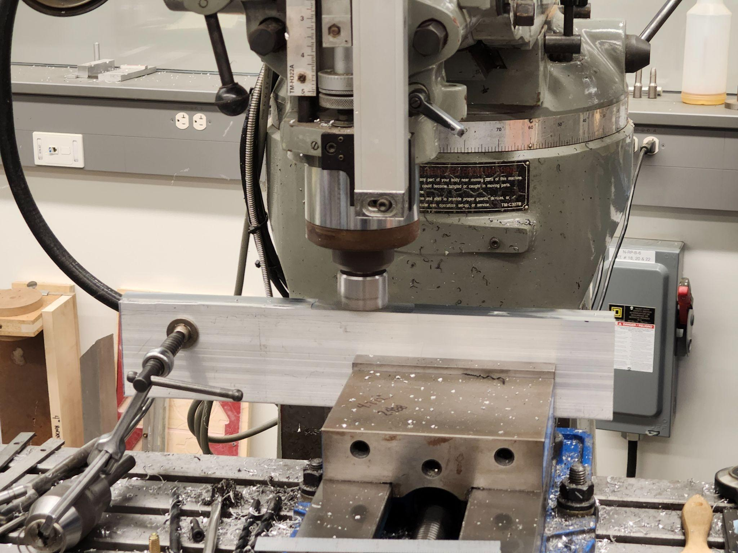
CURRENT WORK
Suspension

Slide 6
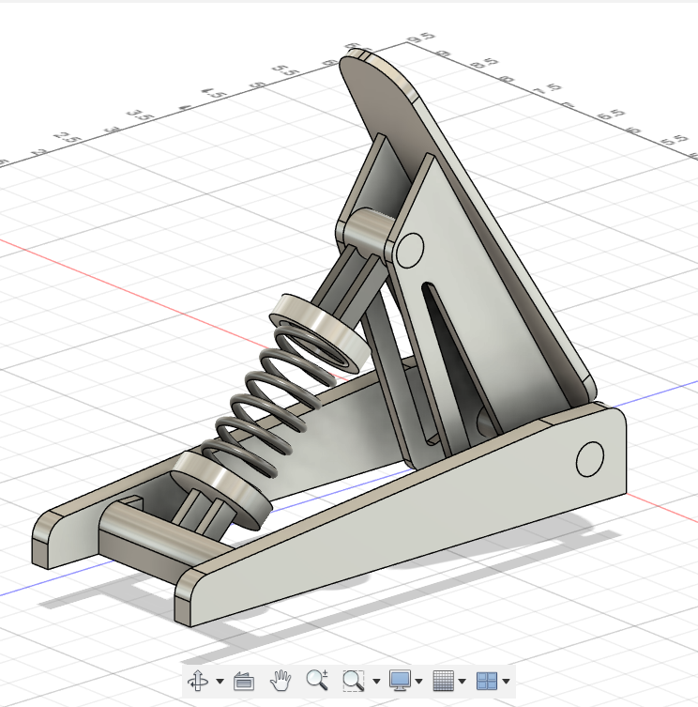
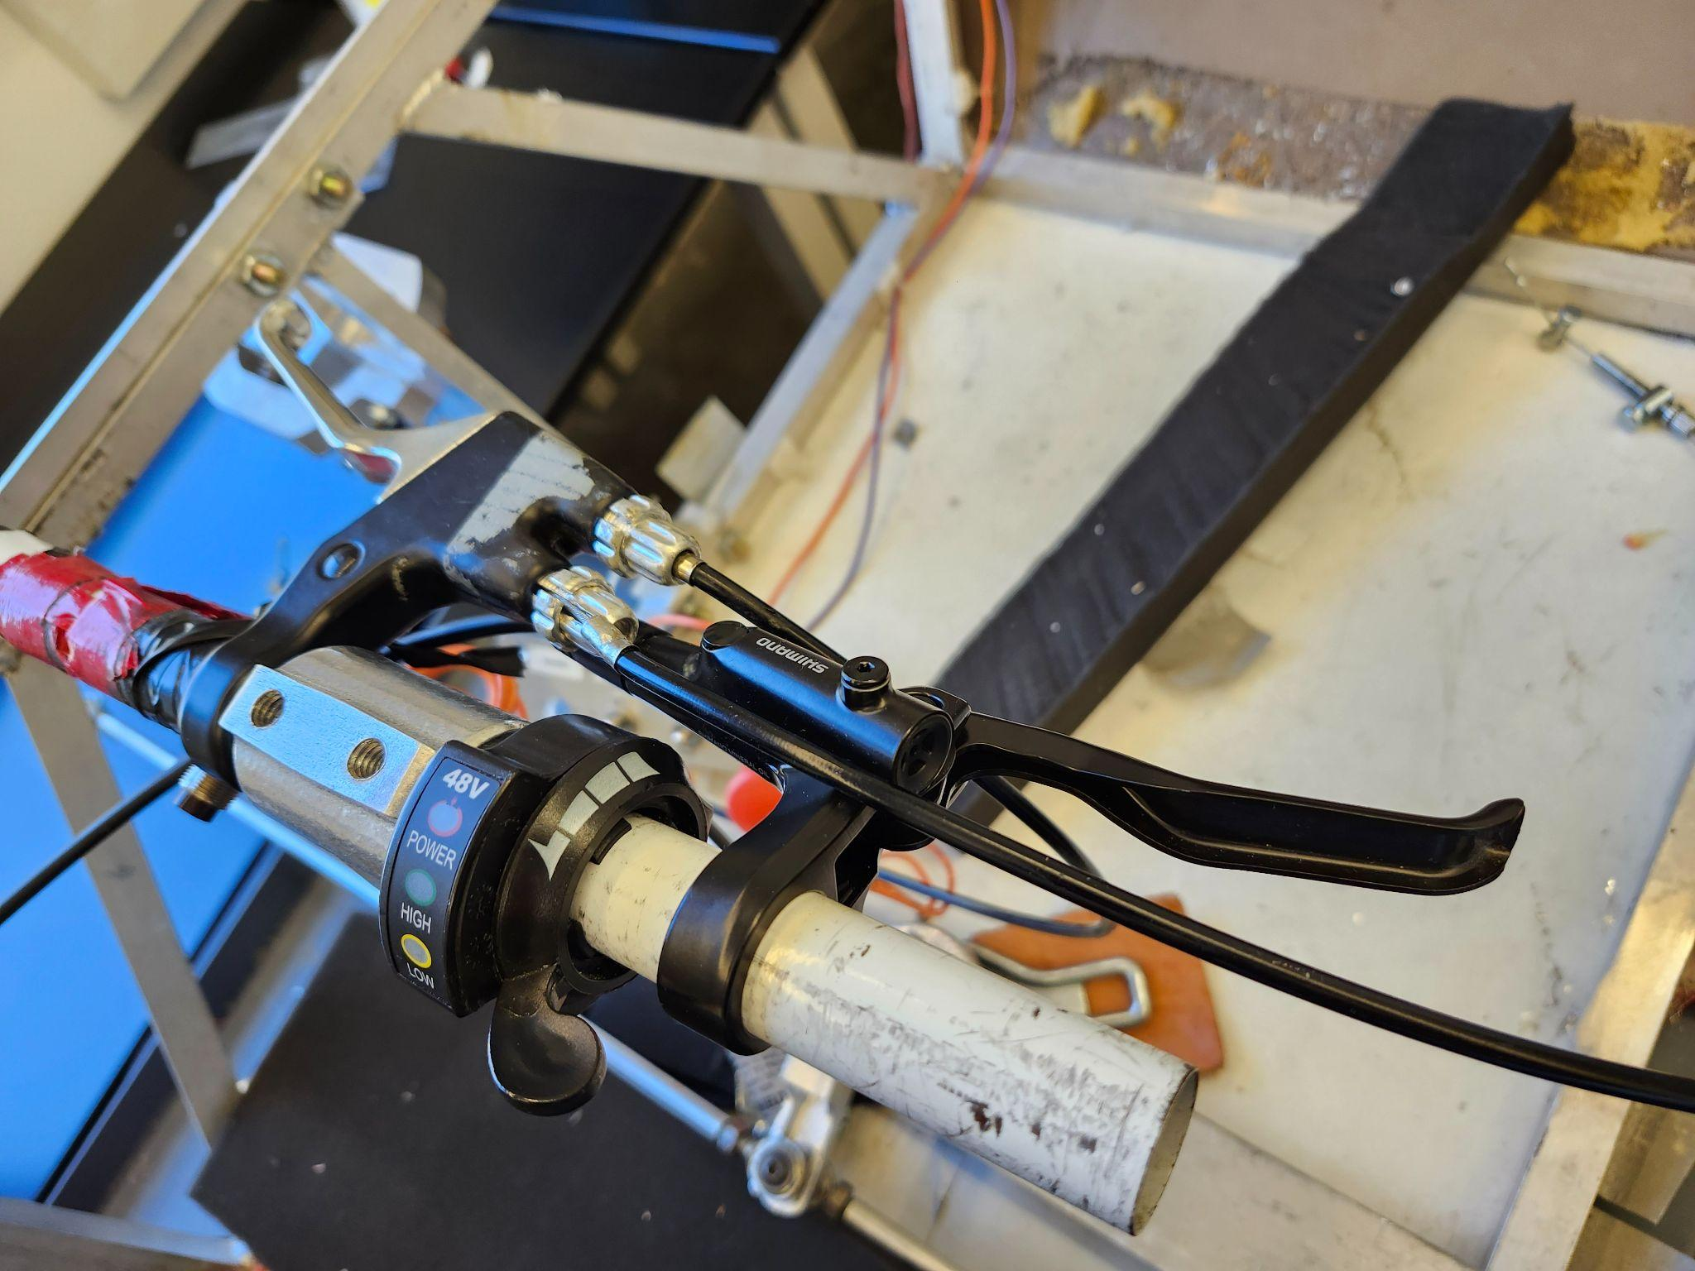
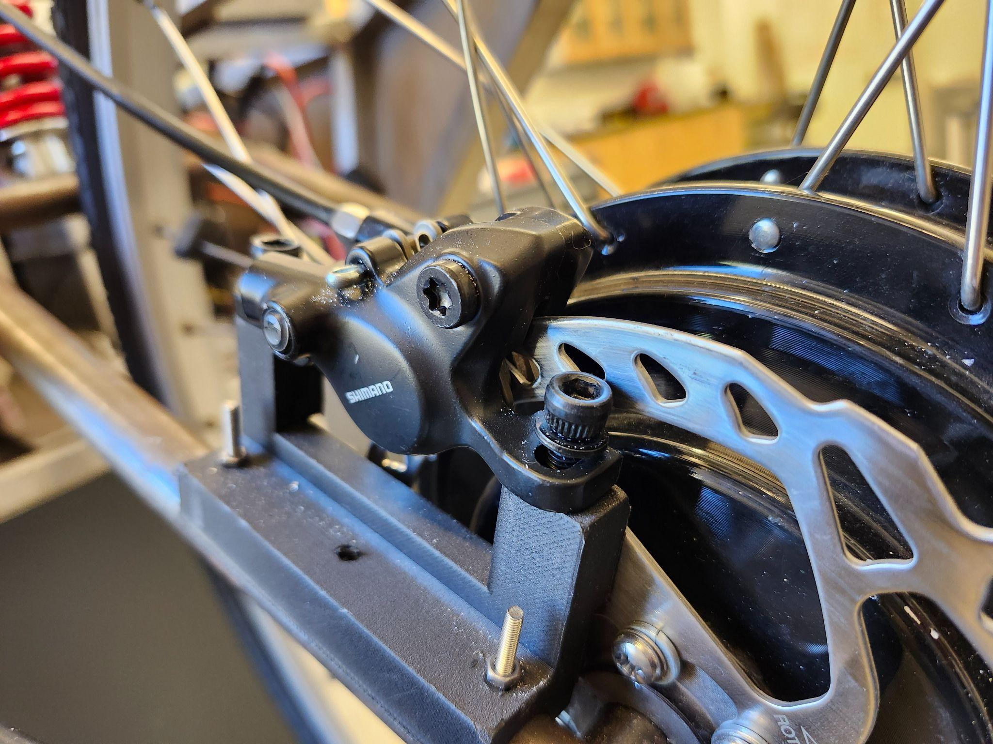
CURRENT WORK
Brakes

Slide 7
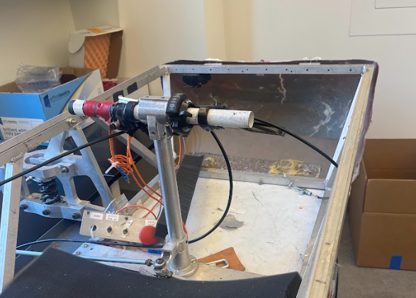
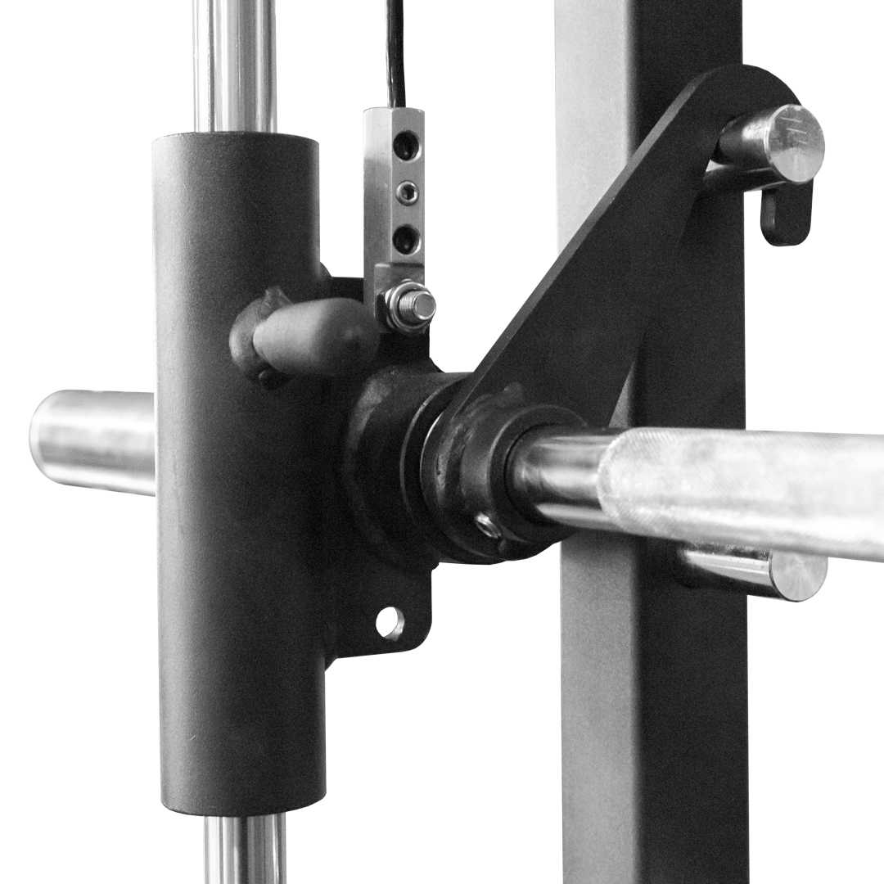
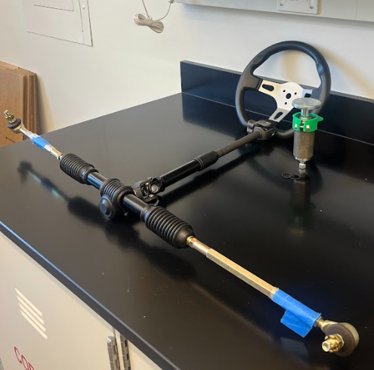
CURRENT WORK
Steering: Rack + pinion
Rack + pinion support inspiration: Link_Image

Slide 8
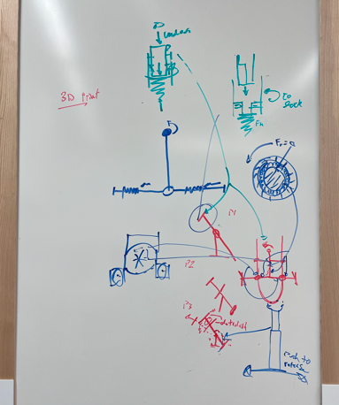
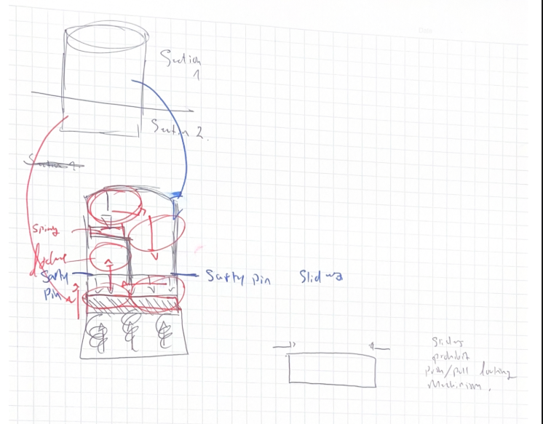
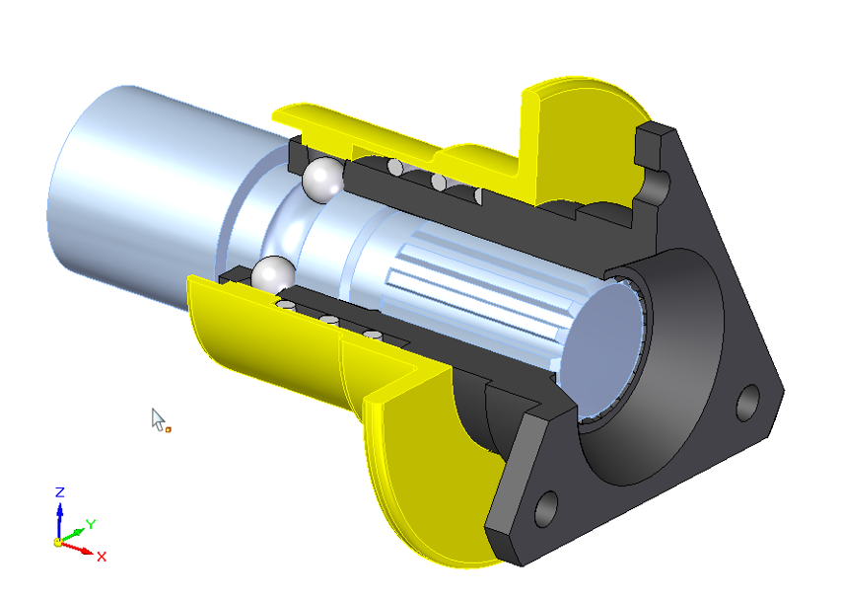
CURRENT WORK
Steering Wheel: Quick Release
Frank Miller

Slide 9
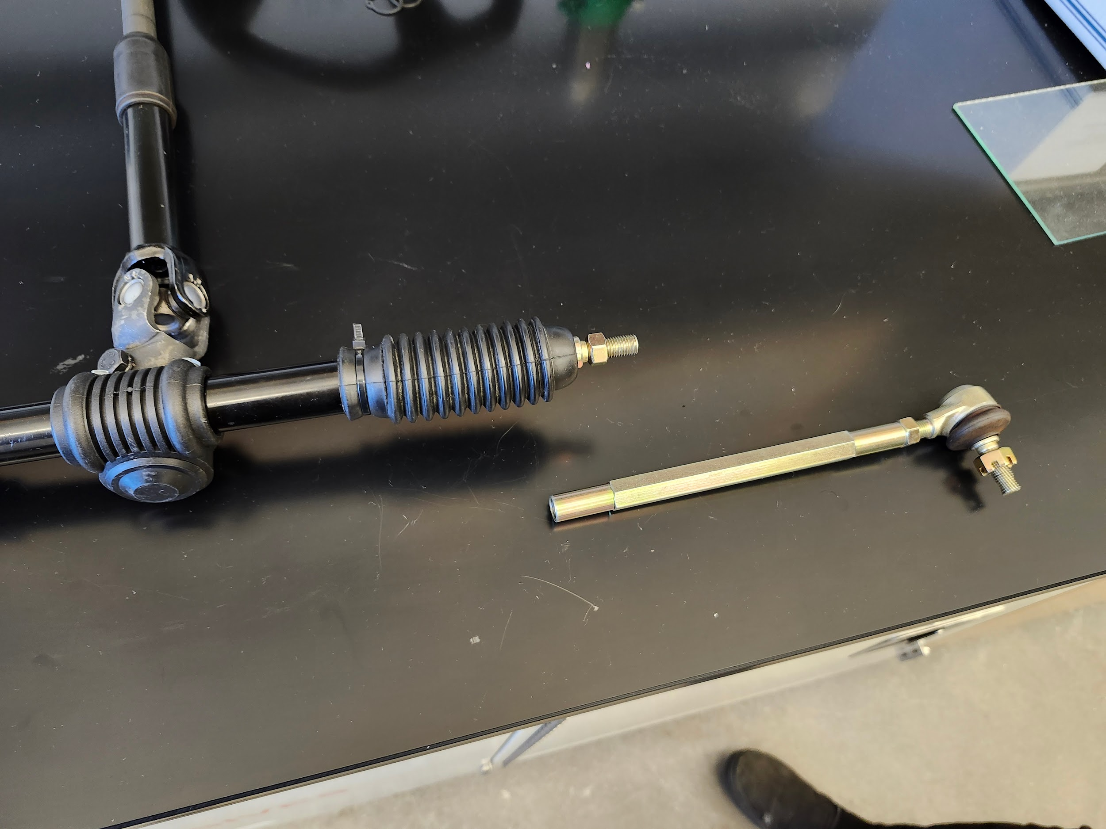
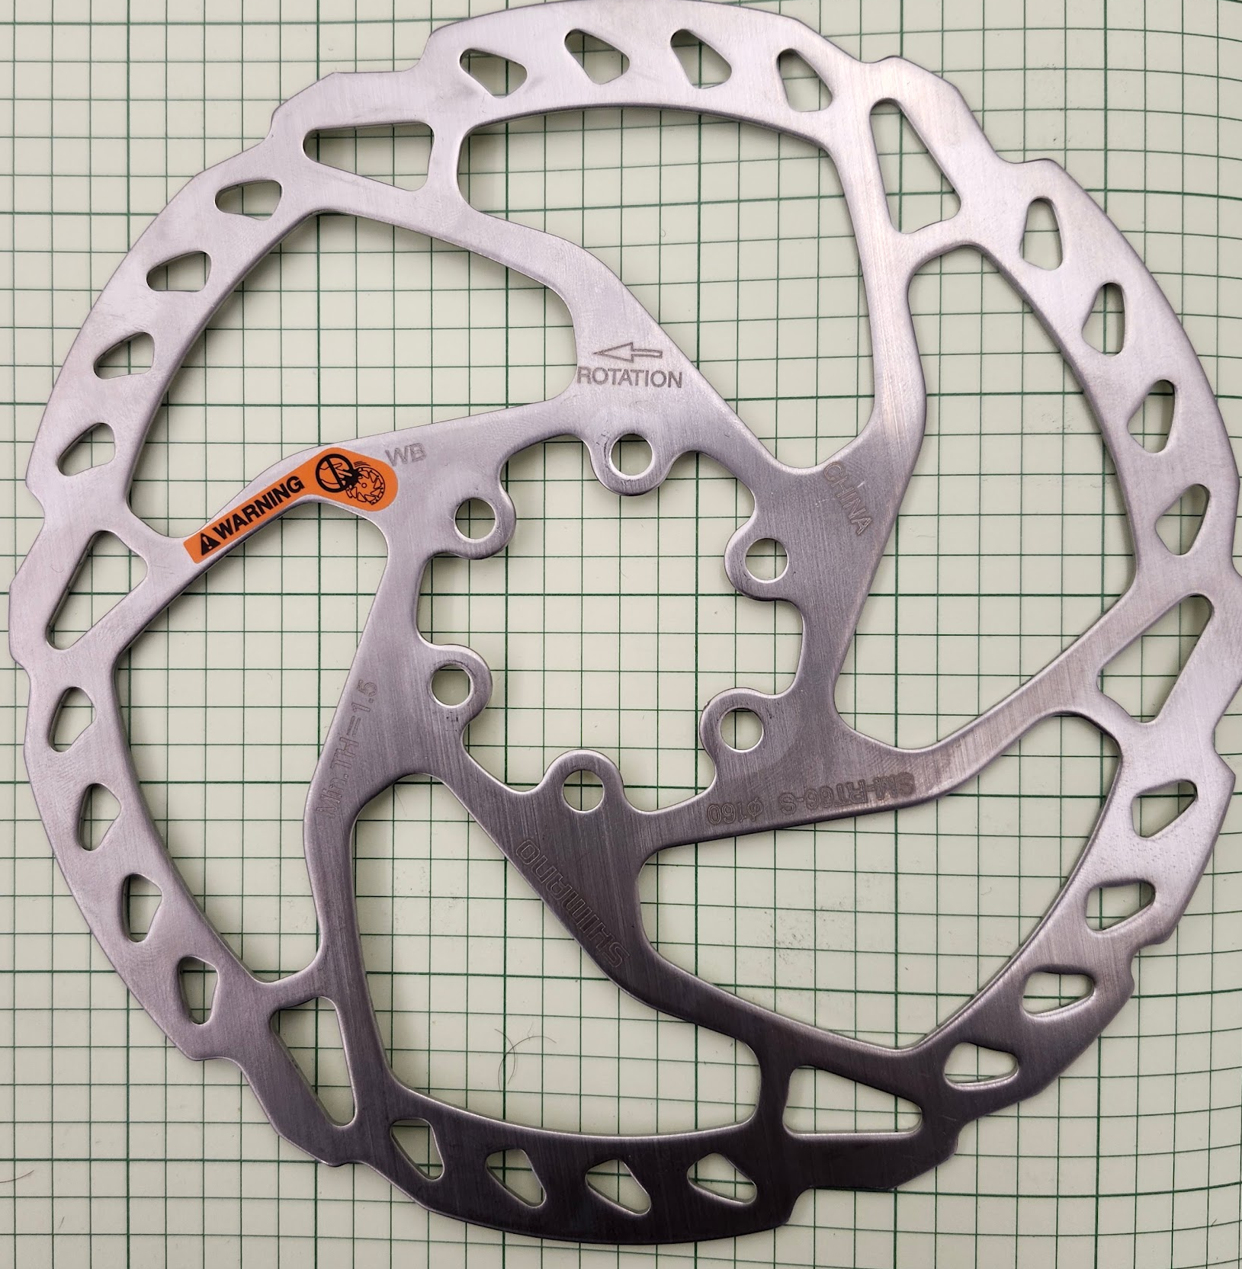
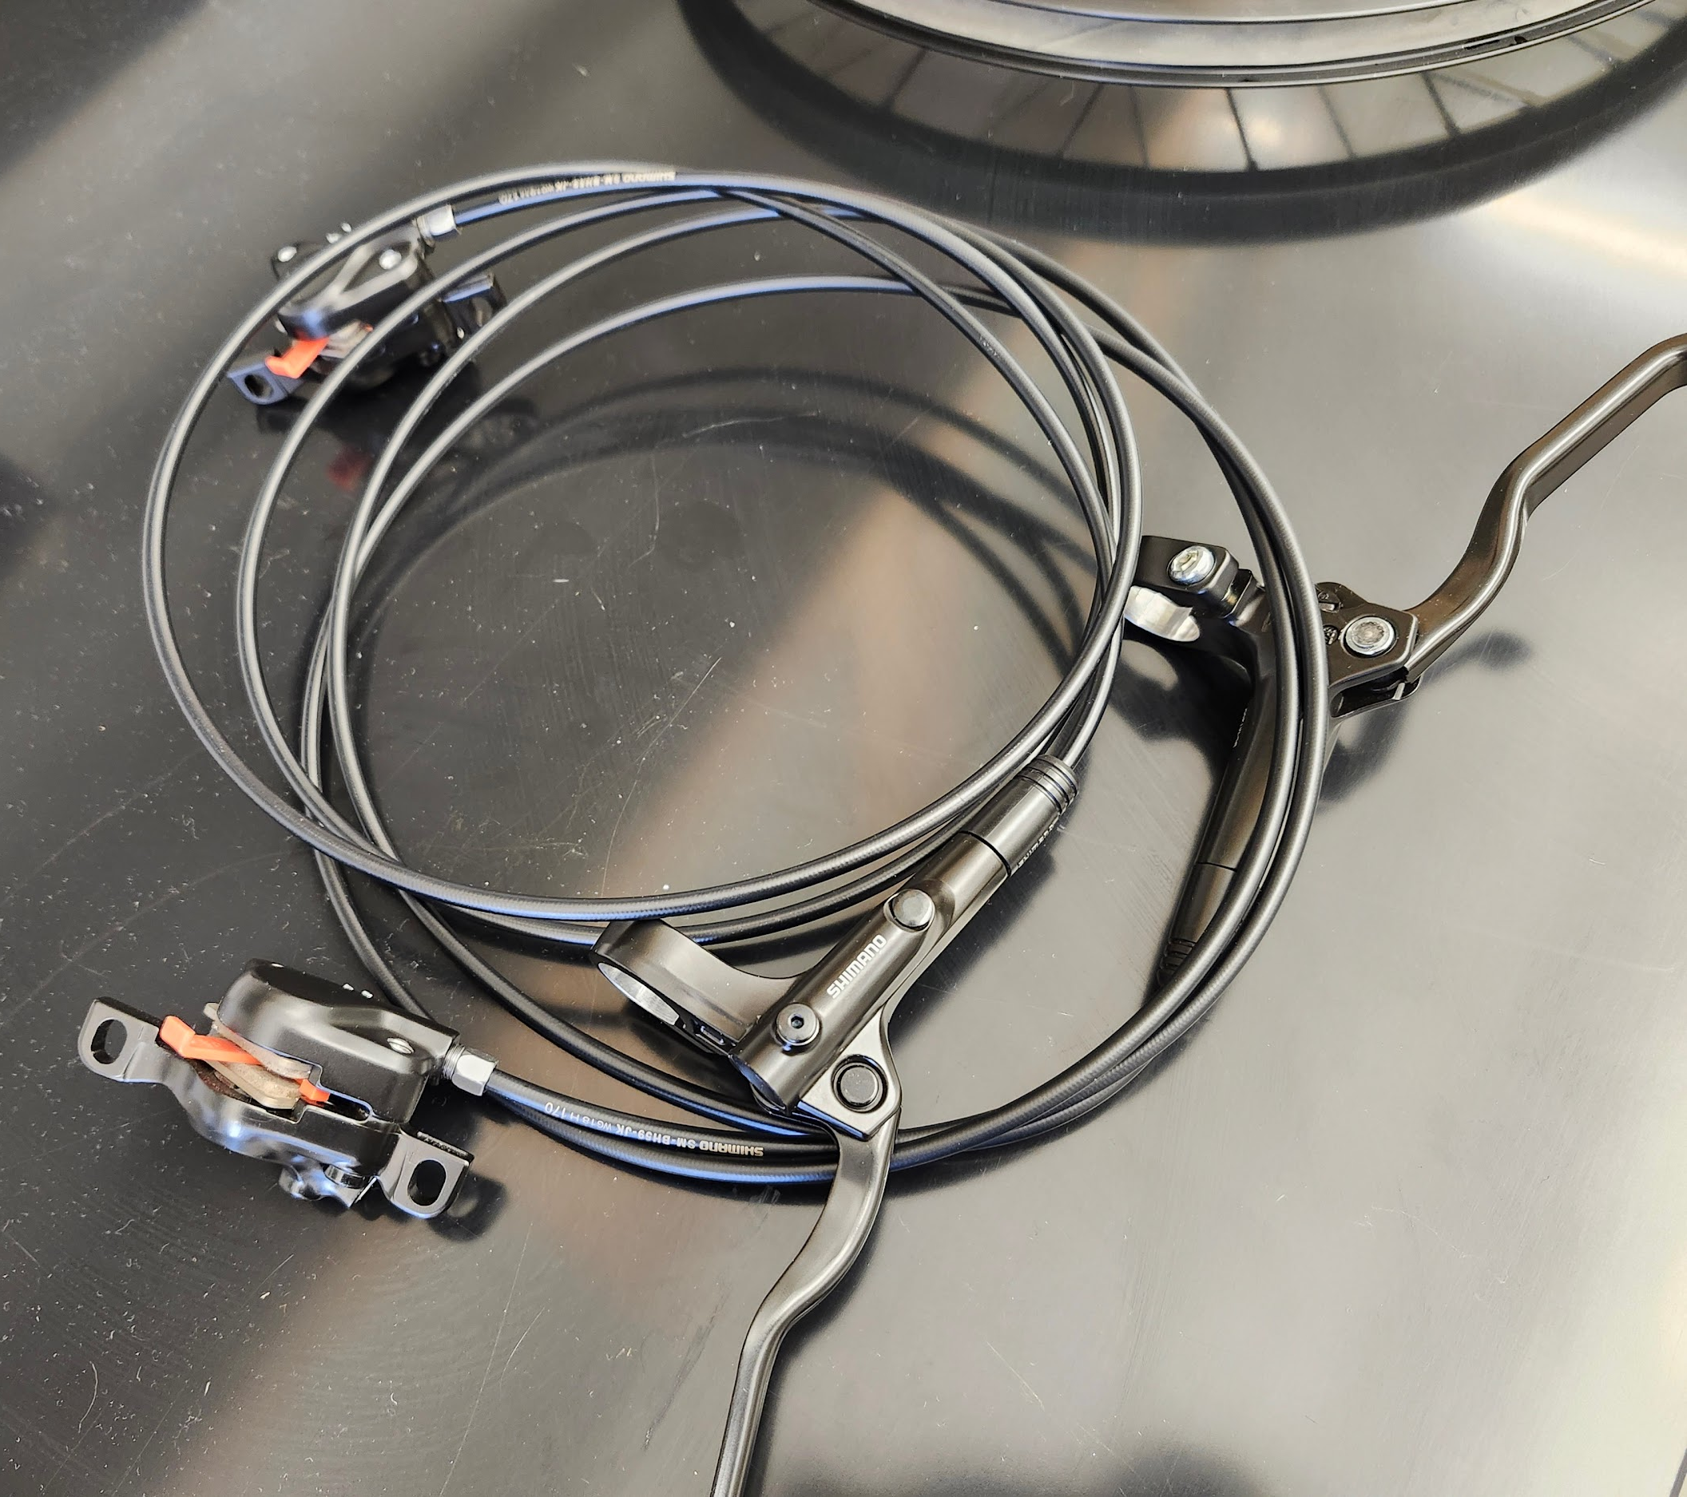
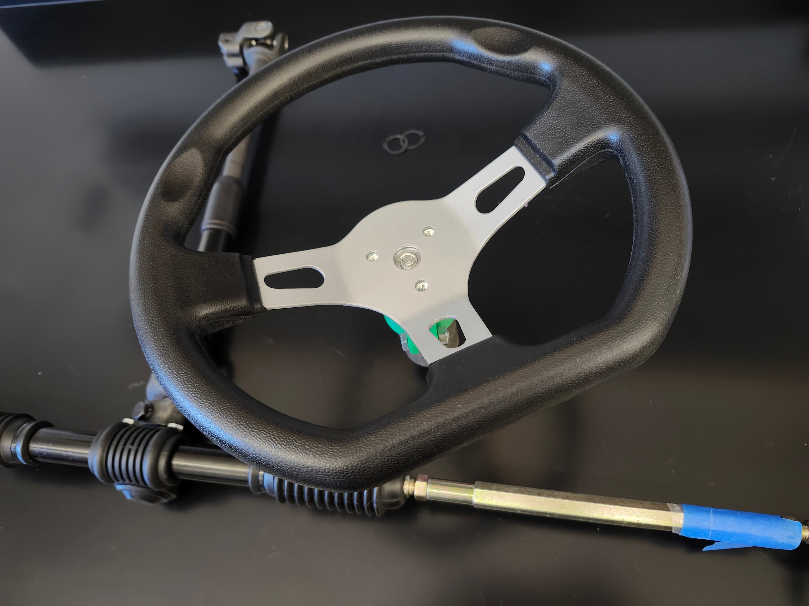
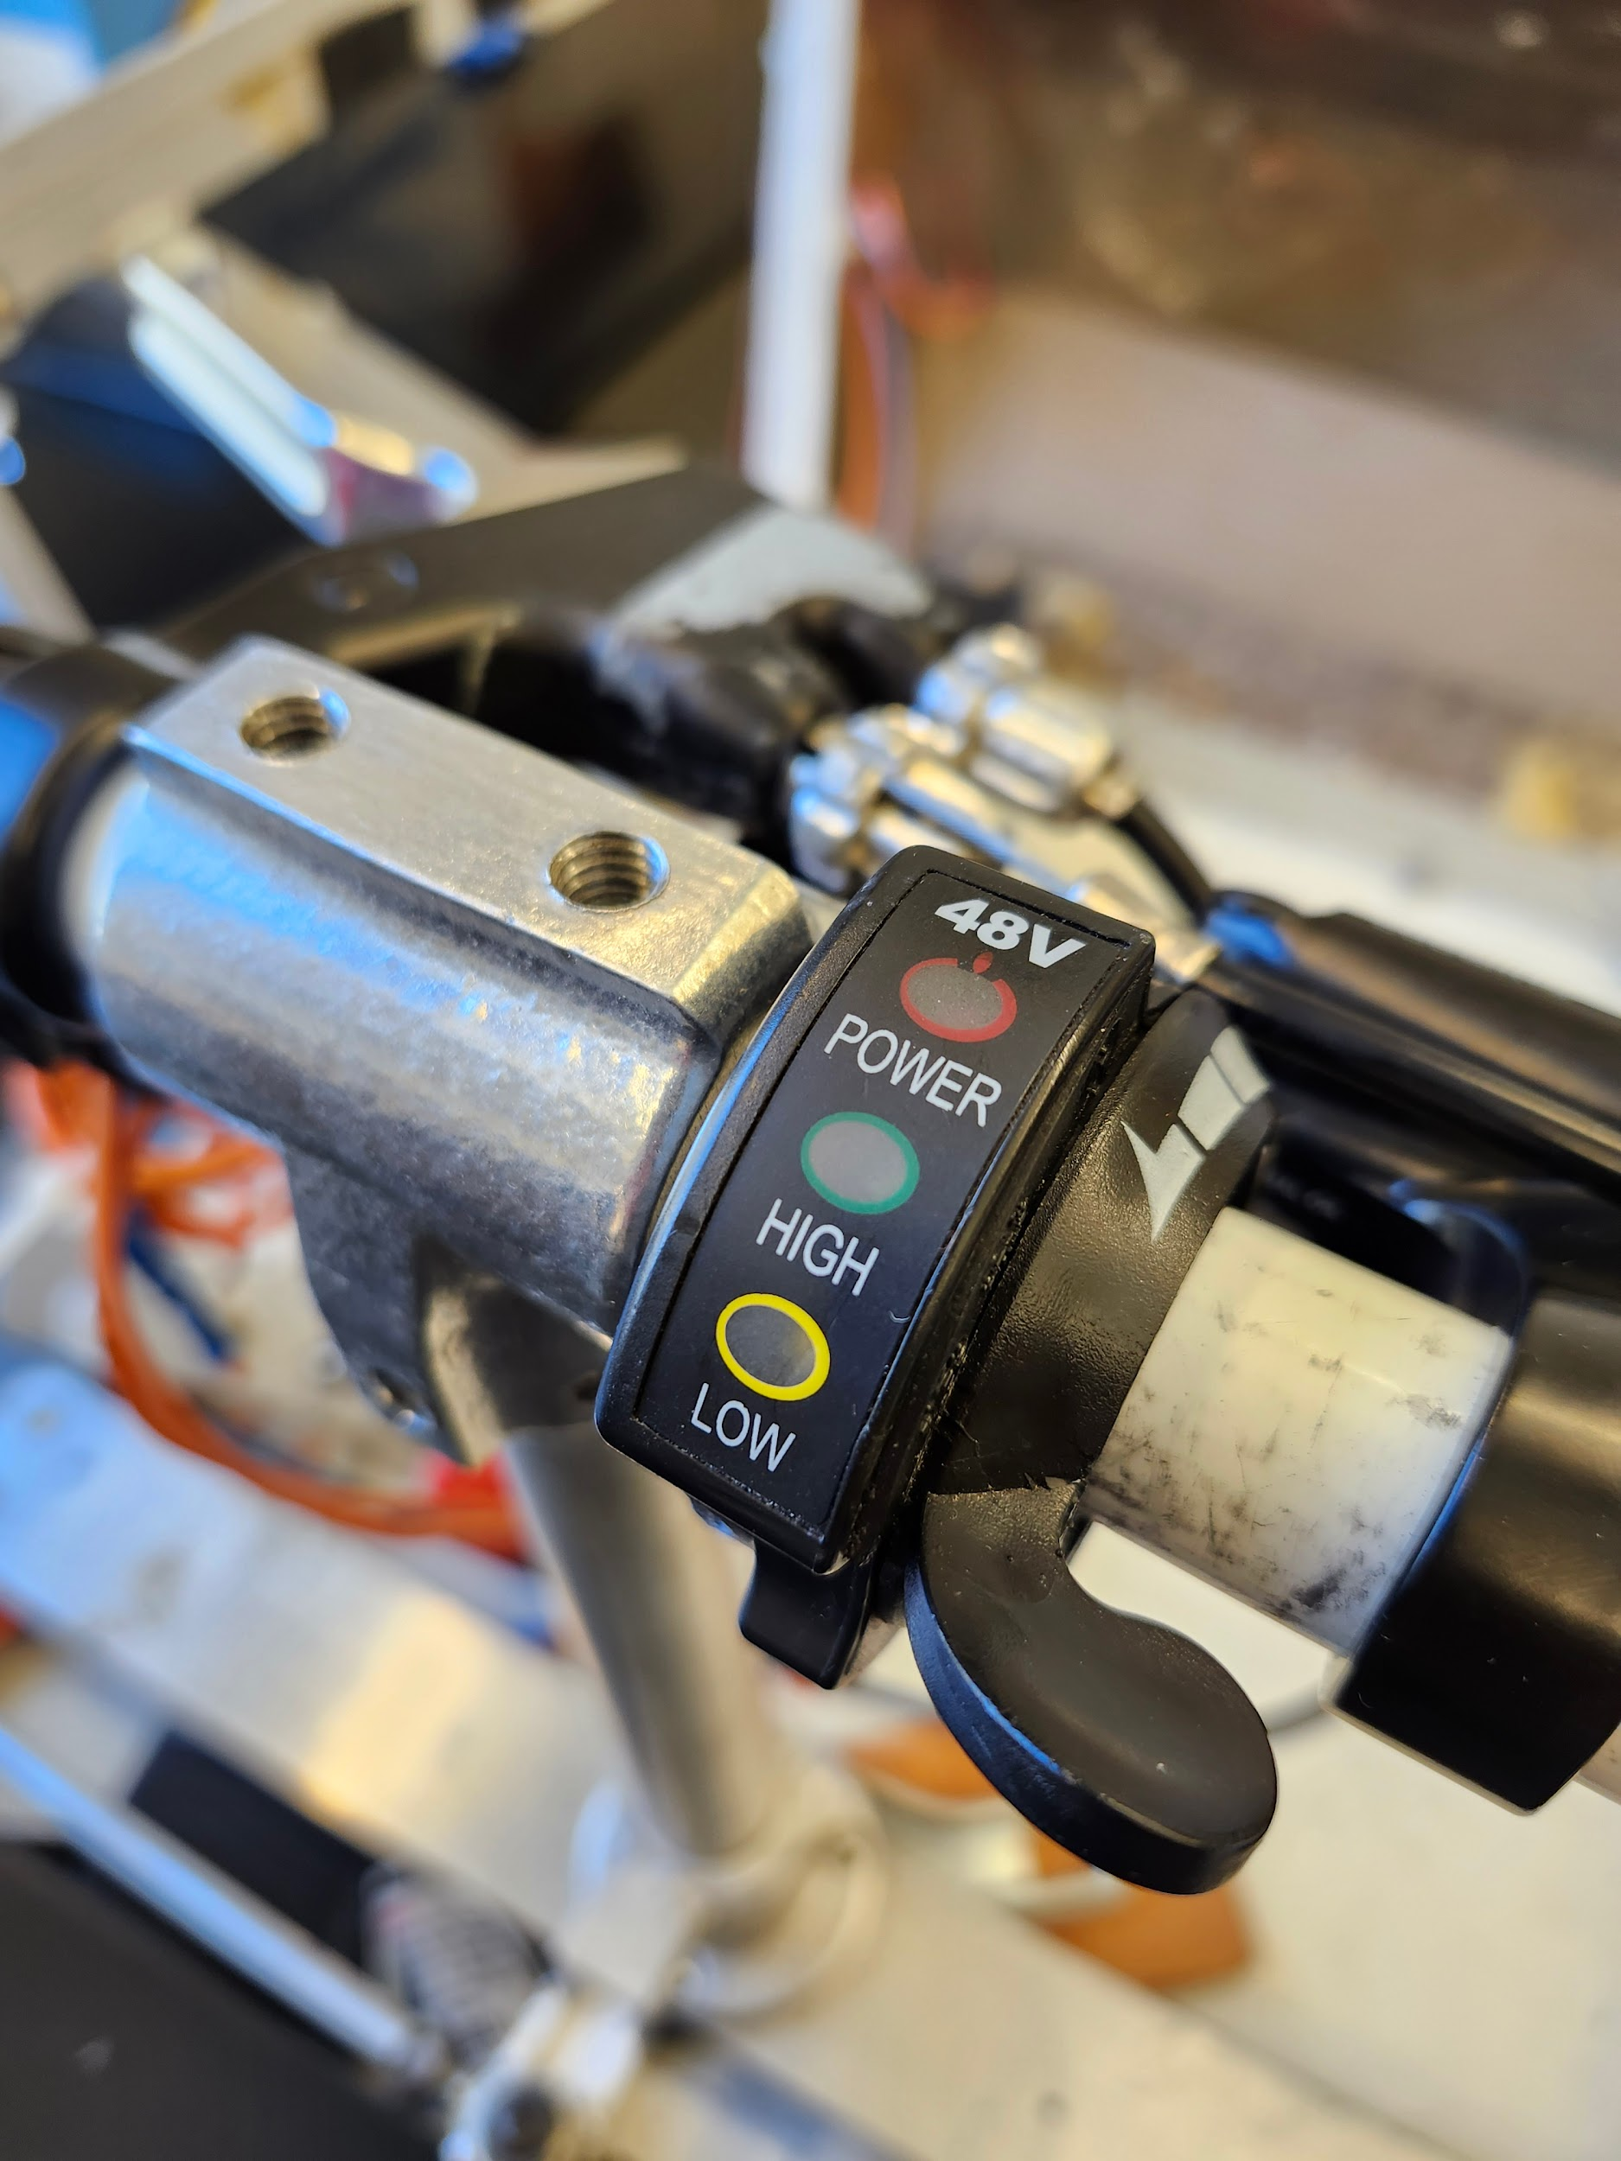
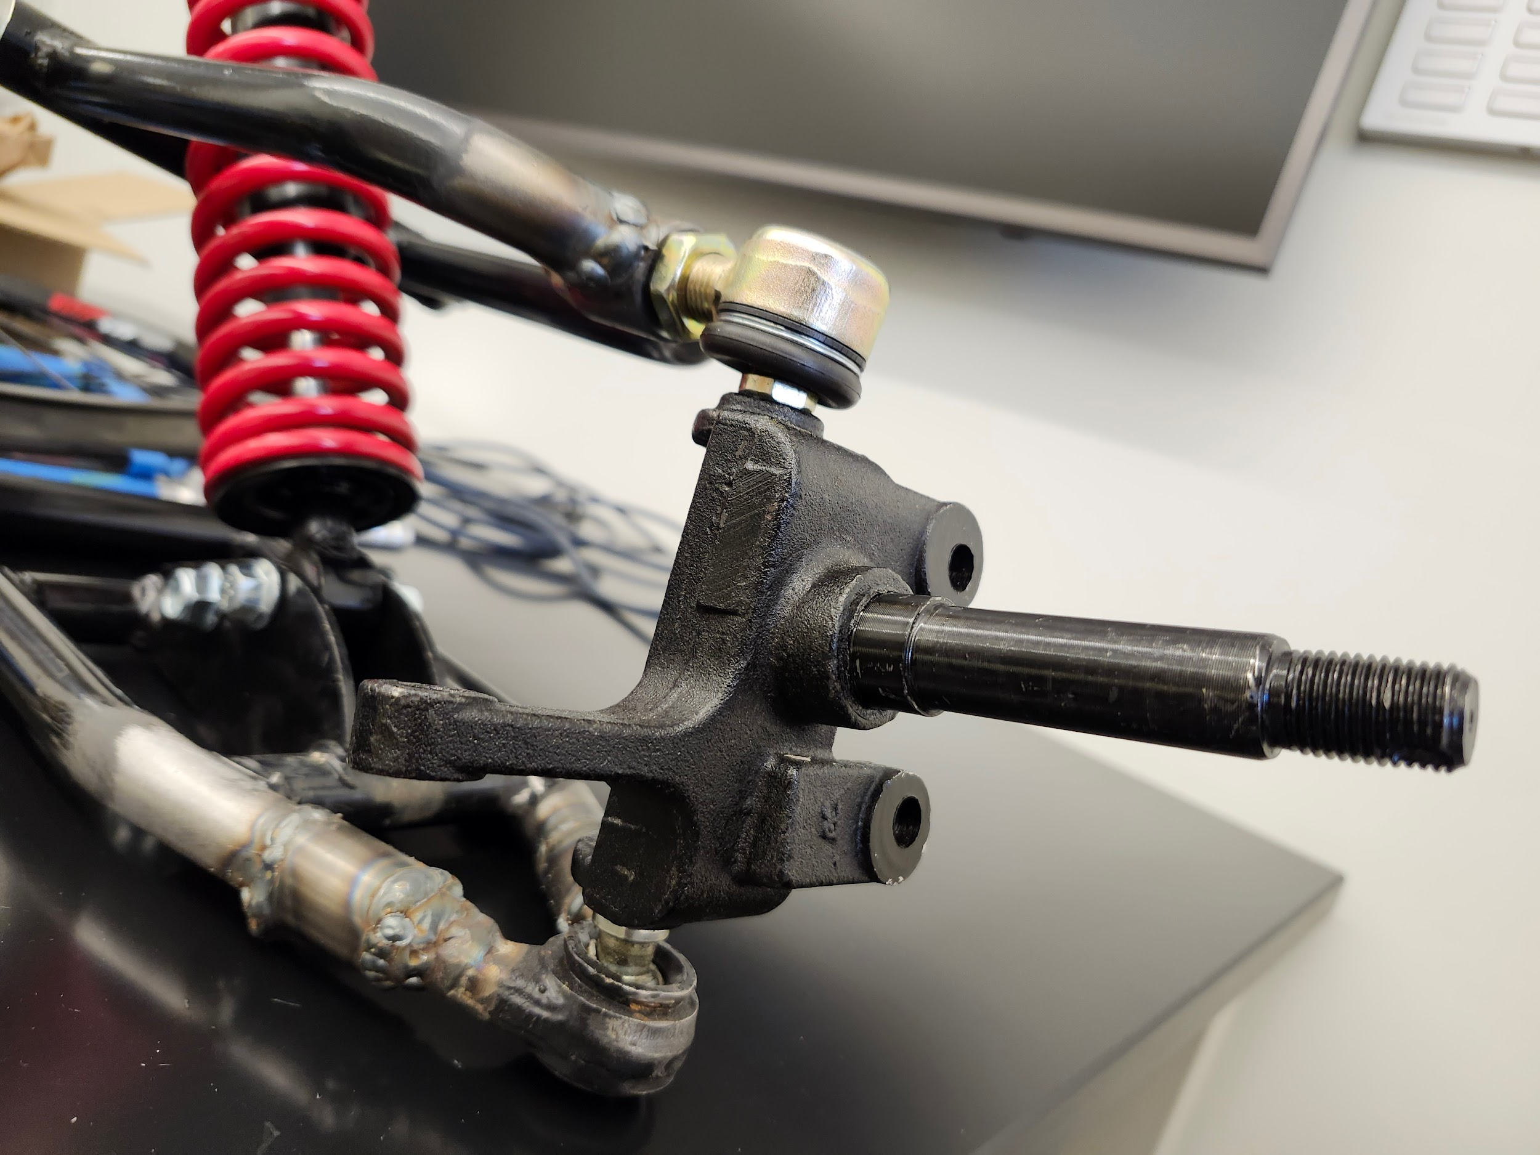
NEXT STEPS
Fit Rack & Pinion System + Steering Wheel
Finish brake system
Finish Suspencion
Modify Power into Pedal

Slide 10
Questions?
Thank You

